Slide 1

ABC Cloud Breach

Slide 2

Client Challenge
In 2018, ABC Bank initiated a modernization program aimed at transitioning its current assets to the cloud, optimizing its assets with containers, and creating new applications to cater to the needs of its clientele. As part of this program, the bank established dedicated cloud teams to facilitate the migration and enhance their operational agility. Unfortunately, in 2019, the bank faced a security breach that resulted in the unauthorized access of millions of customer records and a disruption of its applications for more than 3 days.

Slide 3
Your Challenge
The CISO has reached out to you with a request to conduct a comprehensive assessment of their existing security framework and recommend strategies to prevent future breaches of a similar nature. The CISO is specifically interested in uncovering the underlying causes that led to the breach, taking into account both technological and non-technical factors such as people and processes. The overall objective is to gain a holistic understanding of the breach's root causes and devise effective measures to mitigate the associated risks in the future.

Slide 4
Org Context
ABC Bank is renowned for its exceptional customer service offered through its branches, yet it faced a decline in financial performance from 2014 to 2017. The Bank attributed this trend to the reduced acquisition of new customers, considering its reliance on physical branches to provide services. To tackle this challenge, the CEO launched a five-year modernization program in 2019 aimed at transforming the Bank's infrastructure. The initiative entailed migrating all services to the cloud by 2024, which led to the establishment of a dedicated cloud project team to develop container-based applications while phasing out virtual machines. As of 2020, 50% of the Bank's infrastructure and applications had already migrated to the cloud, while the rest remained on-premise. The Bank's modernization program aligned with its broader strategic plan, with extensive media campaigns planned for Q1 of 2020.

Slide 5
The Incident
In 2018, The Bank suffered a breach that resulted in the disclosure of sensitive information and enabled unauthorized access to the application's source code. Following the breach, The Bank's Cyber Security Incident Response Team (CSIRT) initiated a forensic investigation to gather evidence.
As part of their investigation, the CSIRT team obtained packet captures and logs, which revealed several security issues. Additionally, the team discovered a security alert generated by the on-premise Security Information and Event Management (SIEM) system, which was logged into the case management tool. The team also uncovered emails exchanged between security analysts and the cloud project team regarding the incident.
The CSIRT team observed that the cloud project team lacked established procedures to handle security incidents compared to the on-premise team.
Notes:
, including information leakage, potential denial of service attacks, potential code execution, and reconnaissance attempts

Slide 6
challenges experienced by ABC and why they asked for help
After concluding the investigation, the CISO organized workshops with the security team to identify the root cause of the problem. The team proposed various recommendations, which mainly involved acquiring a lengthy list of next-generation security tools. However, the CISO recognized that beyond the inadequacy of security tools, there were more fundamental underlying problems that required attention. The CISO acknowledged that to prevent similar breaches in the future, he would need to enhance the bank's security methodologies.
Zak has recruited you to conduct a thorough evaluation of ABC Bank's cyber security position, including both on-premise and cloud infrastructure, to address these problems. The Bank has set ambitious targets to transition entirely to the cloud and has implemented numerous new security measures to safeguard its cloud assets. Despite investing heavily in cloud-native security controls and additional security tools, it is apparent that improving the security posture involves more than just acquiring new tools. There is a need for changes in both people and processes, but what specific changes are required?
Notes:
, including information leakage, potential denial of service attacks, potential code execution, and reconnaissance attempts

Slide 7
Your task
The CISO of The Bank recognizes that transformation and innovation are crucial for enhancing their security offerings. Consequently, they have engaged you and your team to assist in this endeavor.
Slide 1: The CSIRT team uncovered critical security issues from the packet captures, which should be addressed. Provide a detailed description of the findings and explain why they are significant.
Slide 2: Identify the root issues that need to be addressed to improve The Bank's security posture. Highlight the key areas that require attention and explain why they are problematic.
Slide 3: Suggest security policies and concepts that would be effective in bolstering The Bank's security posture against attacks similar to those observed in the packet captures. Explain why these policies and concepts would be helpful and how they could be implemented.
Slides 4 and 5: Develop a one-year plan that outlines the initiatives needed to improve The Bank's security posture. Prioritize these initiatives based on their urgency and potential impact. Present this plan to the CISO, detailing the steps involved in implementing each initiative and the resources required.
Notes:
$81,000 - $147,000

Slide 8
The ask
There will be 2 members to report to. Chief Information Security Officer (CISO), and the Manager.
Present your findings, in slides, or even a word document and send it to Utkarsh, and myself.
If you can not figure out the packet captures, don’t worry. Point are rewarded for the rest of the presentation as well. Use the remainder of the time before class to work on this and come up with some ideas.

Slide 9
Background and The Incident
During the incident at ABC Bank, the Bank’s Security Incident Response Team (CIRT) started to gather forensic information to support its post incident investigation
Attached with this case are the packet captures and logs that were gathered by the CIRT
The packet captures found:
Information Leakage
Potential Denial of Service (DOS)
Potential Code Execution
Reconnaissance Attempts

Slide 10
Packet Information
Reconnaissance Attempt
Packet 1
SYN pack – RST/ACK in red, no TCP verify – port enumeration
Potential Denial of Service (DOS)
Packet 2
Single Private IP, constantly pinging with just SYN
Information Leakage
Packet 3
TELENET – data is open and not encrypted
Code Execution
Packet 4
Windows PowerShell exc, event ID 4672- sudo privileges
Notes:
Information Leakage
TELENET – open line of data where data communication is opened and not encrypted. It is displayed in clear text – leaked credential info for ubuntu vm
Telnet is a network protocol used to virtually access a computer and to provide a two-way, collaborative and text-based communication channel between two machines.
MikroTik RouterOS 6.47.8 (c) 1999-2020 http://www.mikrotik.com/ -Old router system – known issue.
DOS – Same IP flooding with syn packets an attempt to shutdown server
Attacker establishes a successful three-way-TCP-handshake as shown by [SYN], [SYN, ACK], [ACK] for reliable connection. The victim is helpless to the DOS attack and as a result, the network was down
Potential Code Execution
Reconnaissance Attempt
Multiple SYN attempts within seconds a part. The attacker continues to search with requests ([SYN]) for open ports, but they are not successful as shown by [SYN], [SYN, ACK], [SYN], [RST, ACK] → the reset is flagged in red

Slide 11
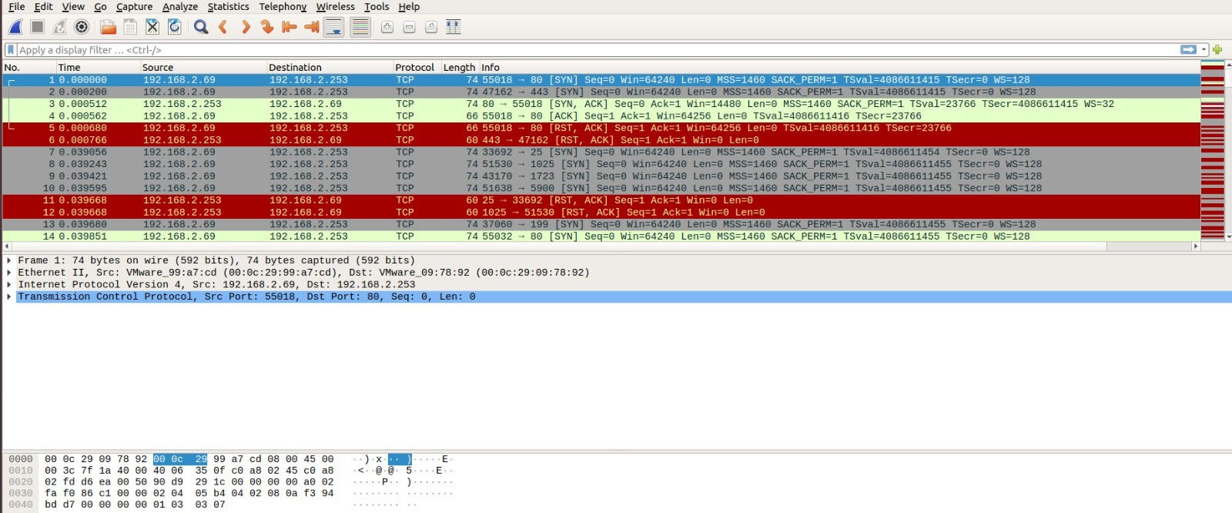
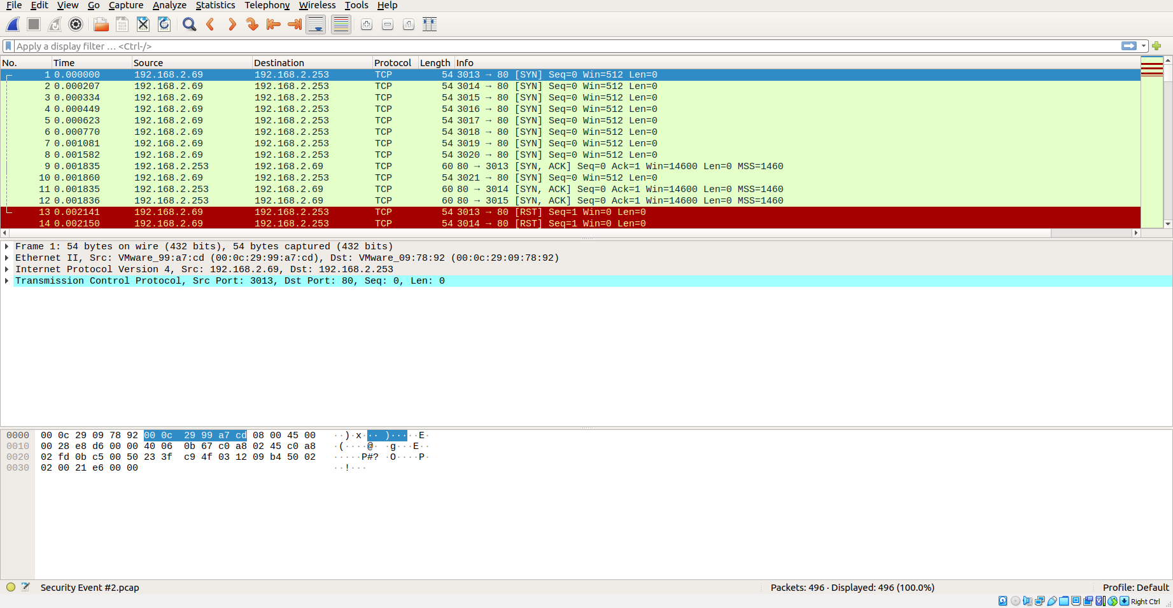
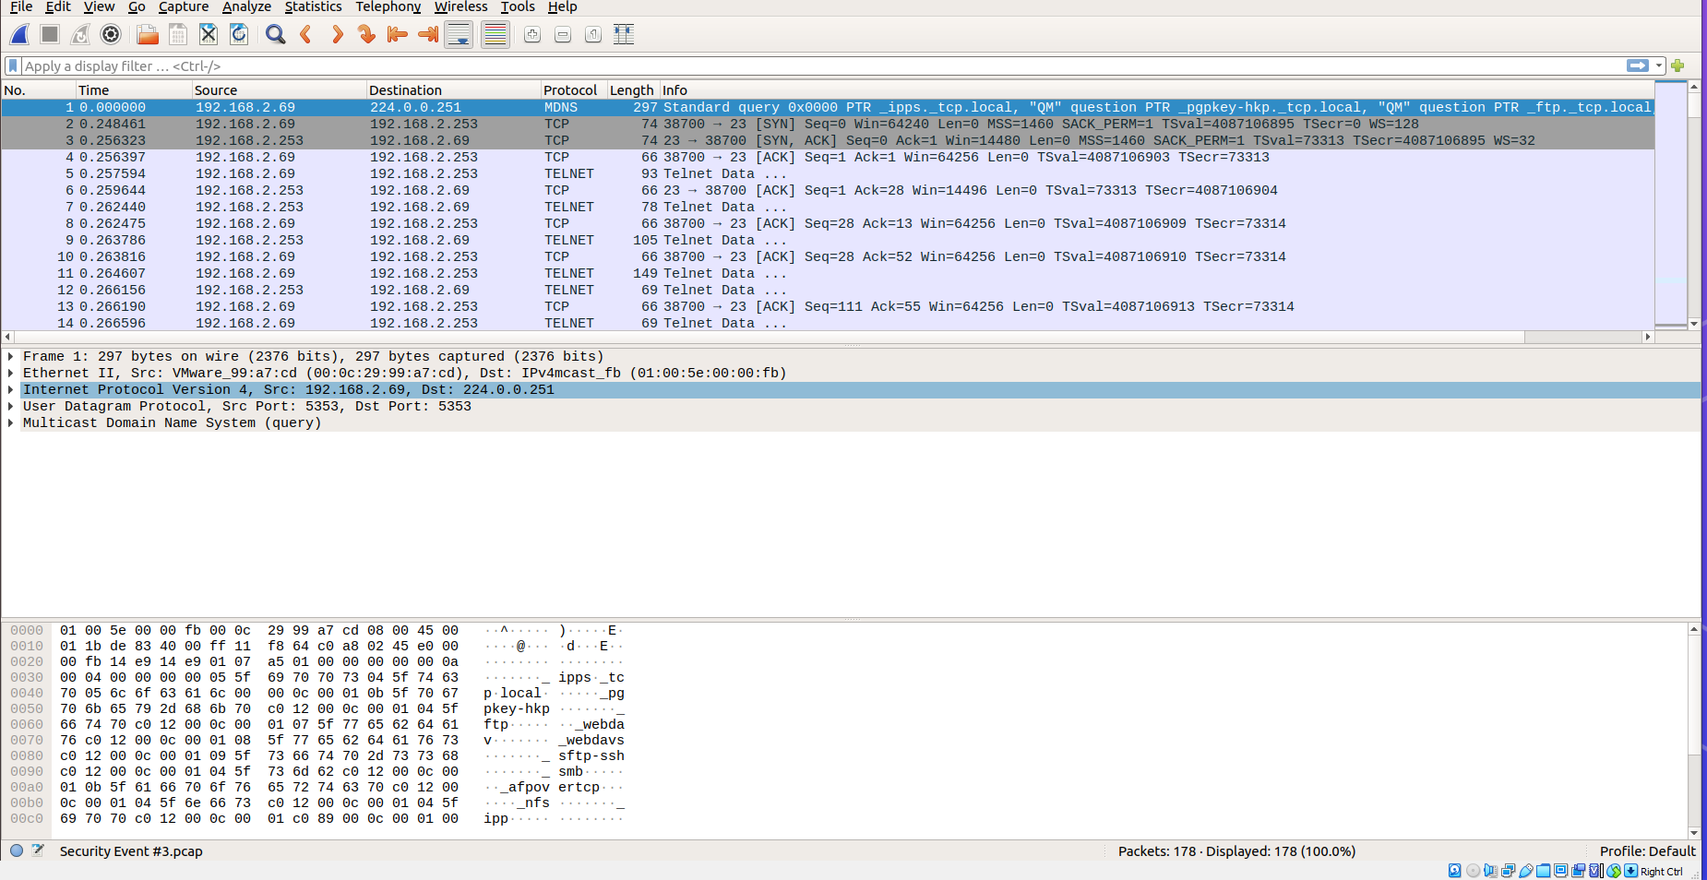

Slide 12
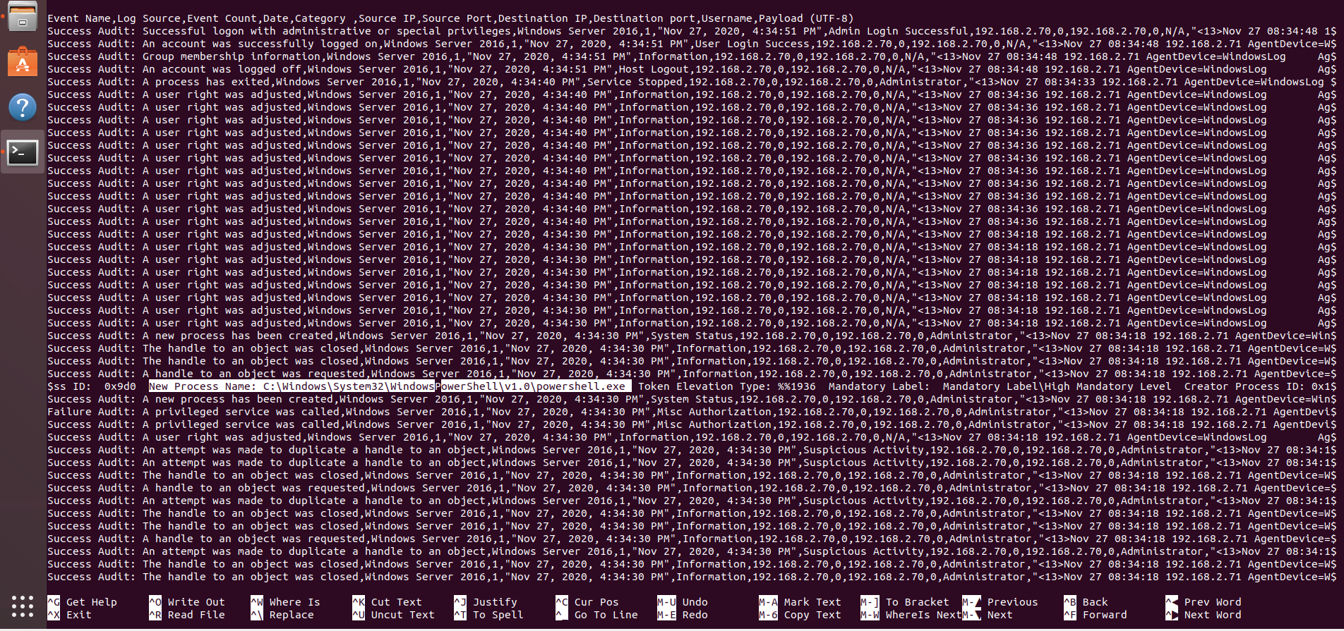
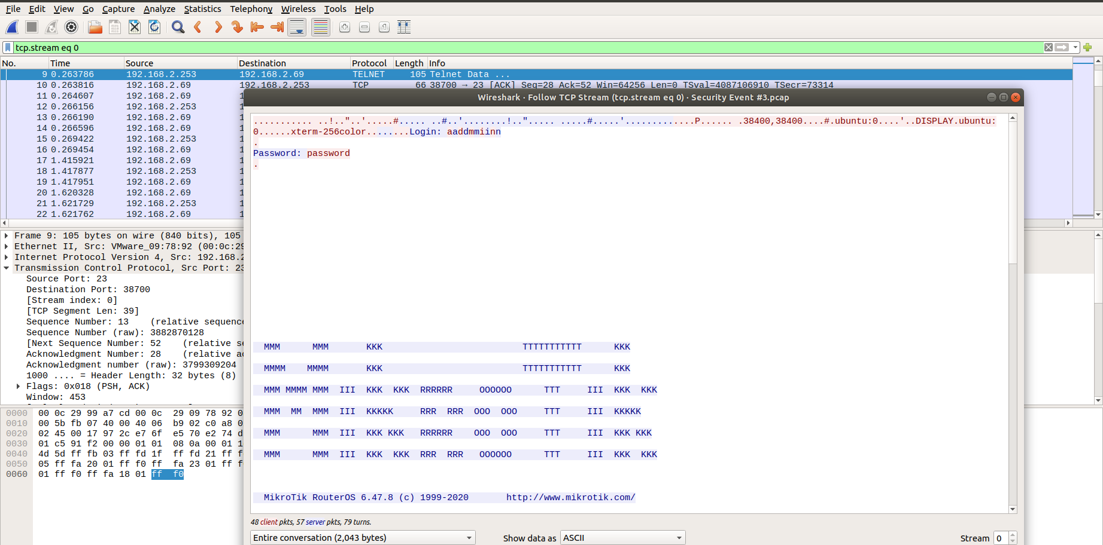
Notes:
PowerShell is a built-in, object-oriented scripting tool that is available in modern versions of Windows. It is extremely powerful and can be used to steal in-memory sensitive information, make modifications to system
It allows tasked to be managed from the command line and automate 1000s of activities i
in simplest forms, PowerShell is a cross-platform shell and scripting language that allows people to manage tasks from the command line and automate thousands of activities. It’s a language built on Microsoft’s .NET Framework that makes many of our lives easier

Slide 13

Root Issues
Inadequate coordination between On-premise & Cloud Teams. Cloud implementation came without preparation.
Old and unpatched security vulnerabilities, default credentials, end life of hardware, privilege escalation, and exposed ports
Employee awareness, lessons learned, and monitoring environments.
Notes:
Open port 80 allowing a DOS flooding
Lack of employee education and training
The most profitable decision isn’t always the most secure. Security objectives may be at odds with those of the business
Different Processes
Cloud team didn’t get alert, but on premise did– where was the communication?
Ensure all servers are routinely patched against latest known vulnerabilities.
Old and unpatched security vulnerabilities
MikroTik RouterOS
Failure to Prepare Incident Response Plan
72-hour downtime, marketing team focused on media blitz

Slide 14

Security Concepts and Policies
Information Leakage
Multi-Factor Authentication
Encryption
Strong Password Policy
Demilitarized Zone (DMZ)
Potential Code Execution
Audit system logs
Access Control Lists (ACL)
Routinely Patched Servers
Honeypot
Potential Denial of Service (DOS)
Firewalls
Monitoring of Unusual Activity
Intrusion Detection Systems (IDS)
Intrusion Prevention Systems (IPS)
Reconnaissance Attempts
SIEMS Tools
Anomaly analysis
Training employees on the Dangers of Social Engineering
Use of IP tools
Notes:
IPS would be more beneficial for the bank to use as they not only alert you of unusual activity, but they stop an attack as soon as it occurs
IDS – Alerts t
DMZ – Extra layer of protection between public and private networks.
Strong Password Policy
Encryption
Multi-factor Authentication
Use of IP tools
Nmap
Anomaly analysis – looking for activity that’s not normal

Slide 15
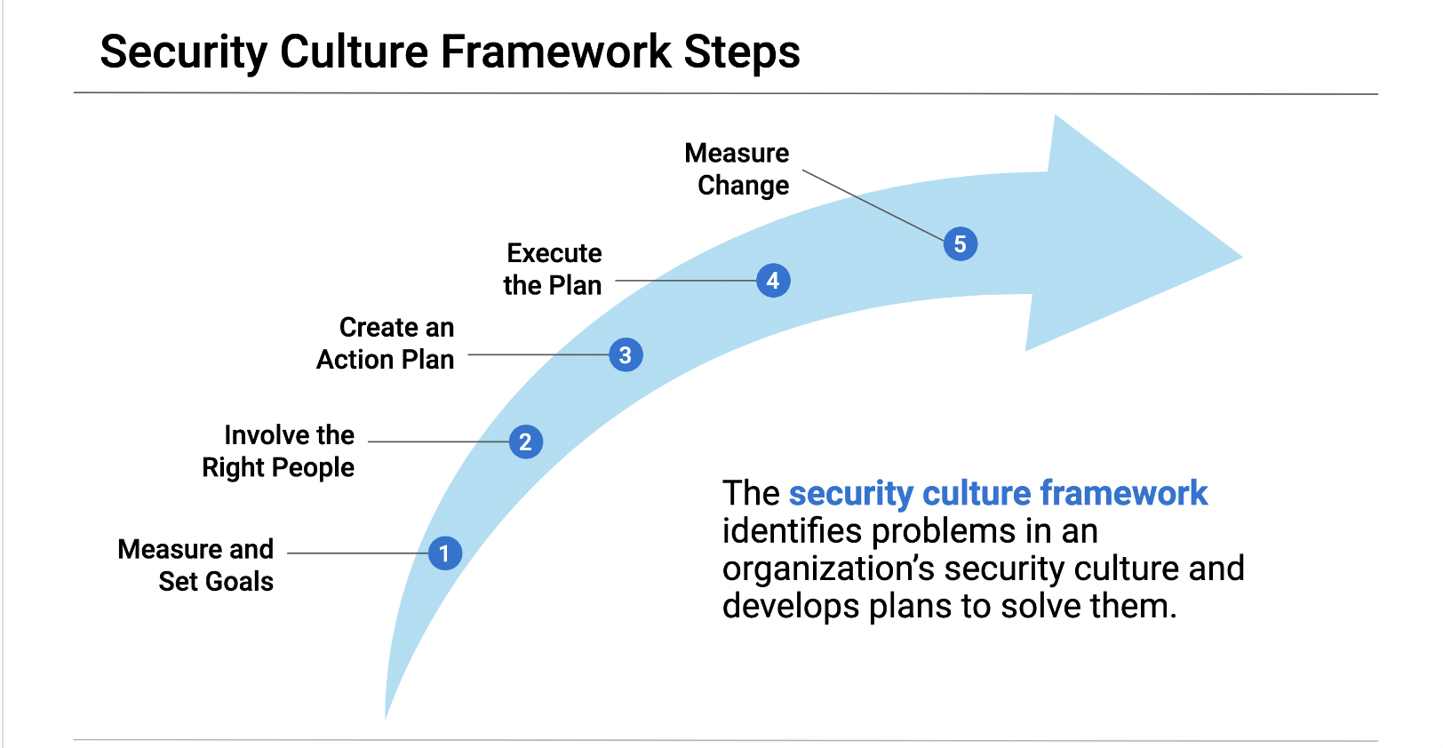
Prioritization and Plan
Supporting the Security Staff
Content Filter
Detection Setup
Prioritizing Risk Mitigation
Access control and management
Backup Storage Security
Frequent patching/updates
Conducting Annual Staff Awareness Training
Goal of Training 25% of Employees Each Quarter
Training to Cover Consequences of Security Awareness, Privilege Misuse(Root & Sudo), and weak passwords
Gathering feedback from employees through surveys
Notes:
Access control and management: Review identity and access management, including user accounts, roles, and key management
Hot site, warm site, cold site
Storage security: Assess posture of cloud storage including object-level storage, block-level storage, and related snapshots
Improved resilience: The team performing the cloud security assessment will provide recommendations to help organizations recover from a breach faster.

Slide 16

Prioritization and Plan
IBM Case Challenge
Regular Reviewing of Policies and Procedures
Policies related to remote access, strong password controls and management, and rules of acceptable use of devices
Results in understanding of security obligations and training
Collaborating with HR and other departments to determine best practices
Assess and Improve
Determination of plan’s success or failure with regular security audits in place
Setting target goals with timelines
Specify KPIs indicating what you want your plan to achieve
Notes:
%5 click rate.
Surveys in place to check employee awareness
E.g., Intrusion attempts, mean time to detect, and resolve, security incidents KPIs
Security Incidents,
Level of Preparedness
‍How many devices on your corporate network are fully patched and up to date
Time in takes to patch.

